Slide 1

Can We Create Our Own AUTOSAR?
Exploring custom AUTOSAR implementations in automotive electronics
ID | NAME | SLIDE
30396 | ASIMA NAYAK | 1,2
30393 | SAGAR CHOUDHARY | 3
30399 | TITHI MALLICK | 4,5
30381 | THANUJA M | 6,7
31134 | ANKIT PANT | 8
31251 | RITIKA CHOPRA | 9,10

Slide 2

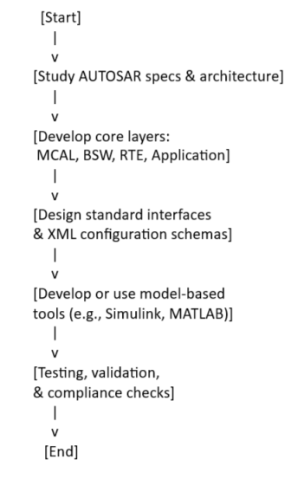
Introduction to Automotive Electronics
Growth of electronics in vehicles: from simple relays to complex ECUs
Modern vehicles: 100+ ECUs, increasing need for software innovation
Importance of standardization and modularity in development

Slide 3

ECUs, CAN Bus & Network Topologies
ECUs: Electronic Control Units – the “computers” running vehicle systems
CAN Bus: Dominant in-vehicle communication protocol
Network Topologies: Star, bus, hybrid; scaling challenges as features grow

Slide 4

Embedded Software Architecture in Automotives
Software layered on hardware; need for abstraction
Real-time constraints, safety, reusability
Drive for standard practices: AUTOSAR emerges

Slide 5
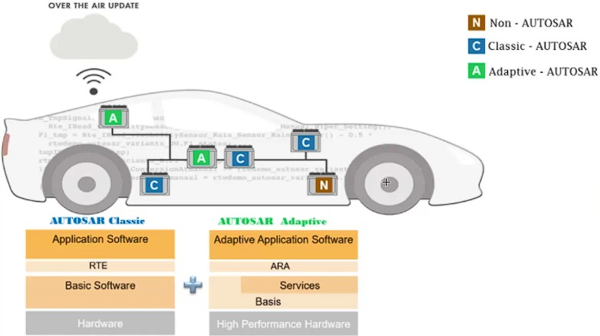
Basic Concepts of Automotive Embedded Systems
Functionality split between hardware (ECUs) and software
Safety and real-time requirements
The role of standards in enabling interoperability and scalability

Slide 6
Overview of AUTOSAR
Definition: Automotive Open System Architecture
Purpose: Standardized software framework for automotive ECUs
Benefits: Modular design, hardware independence, reusability

Slide 7

AUTOSAR Layers and RTE Concepts
Application Layer: Application software components (SWCs)
Runtime Environment (RTE): Communication middleware between applications and basic software
Basic Software (BSW): Services, communication, drivers
Microcontroller Abstraction Layer (MCAL): Hardware drivers

Slide 8
Can We Create Our Own AUTOSAR?
Possible, in theory:- Specs are open; anyone can read and implement them
Real-world challenges:- Requires huge effort, team expertise, and compliance with automotive safety standards
Toolchains for code/configuration generation are as complex as the software itself
Commercial solutions and membership in AUTOSAR consortium often preferred for production systems
For Research/Prototyping:- Feasible to build small-scale modules or prototypes
Open-source and model-based tools (like Simulink, MATLAB) exist for educational and R&D purposes

Slide 9
Steps Involved in Building a Custom AUTOSAR
Study the AUTOSAR layered architecture and specs in detail
Develop core layers: MCAL, BSW, RTE, and Application Layer
Design and implement standard interfaces and configuration schemas (often XML)
Develop or utilize model-based tools for configuration and code generation
Testing, validation, and compliance checks

Slide 10
Conclusion
Building your own AUTOSAR is educationally rewarding but resource-intensive
For most production/programming use-cases, adoption of commercial or open-source AUTOSAR stacks is more practical
A deep understanding of automotive embedded systems, architecture layers, and communication protocols is essential to even attempt this task

Slide 11
THANK YOU!

